Slide 1



Relative Date Filters in Alma Analytics
Yoel Kortick
Senior Librarian

Slide 2


Introduction
Examples
abc
https://slidemodel.com/templates/animated-rainbow-business-powerpoint-template/
http://image.shutterstock.com/z/stock-photo-business-hand-writing-blank-agenda-list-130255148.jpg

Slide 3
Introduction
Relative Date Filters are used to filter for a date period that is relative to when the report is viewed.
For example, relative filters can be used to retrieve only the current month, the year to date, or the past 7 days.
Relative date filters make it easier to create views that do not require a user to manually change the filter or fill in a prompt. Every time the report is run the date is filtered relative the current date on which it is run.

Slide 4
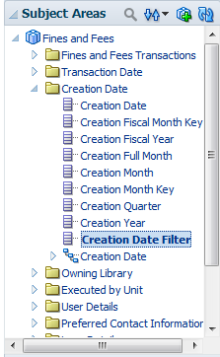
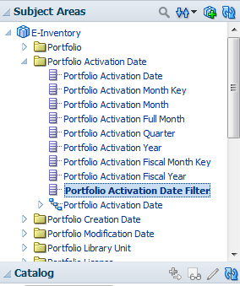
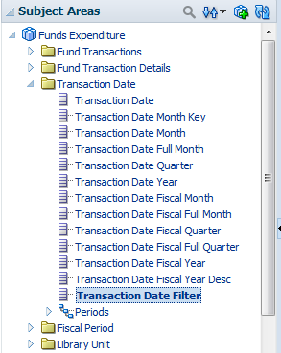
Introduction
The new date filter field appears in the various date dimensions. Here it is for example in three different subject areas in three different dimensions.

Slide 5
Introduction
The new date filter field allows the user to easily filter the date by a relative value such as:
  Current Year
  Previous Year
  Two Years Ago
  Last 365 Days
  Current Month
  Previous Month
  Last 30 Days
  Last 7 Days
  Current Fiscal Year
  Two Years Ago

Slide 6
Introduction
Until now (Nov. 2017) if someone wanted to filter by the last 7 days, for example, he or she had two choices:
Every time he or she ran the report he would need to choose “greater than or equal to” and select whatever date was 7 days ago.
Write an SQL such as:
>= TIMESTAMPADD(SQL_TSI_DAY,-7,CURRENT_DATE)

Slide 7
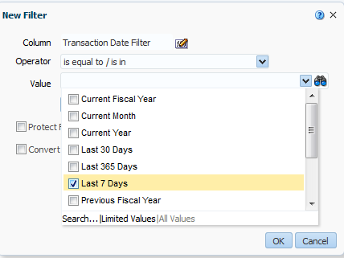
Introduction
Now the user merely needs to choose the following in the filter.
He or she chooses it one time and saves, and it will always retrieve from 7 days ago, whenever the report is run.

Slide 8
Introduction
It is easy to understand how to use the new feature, as there is a pop-up text with instructions in the User Interface.
The instructions are also in the On Line Help, but the staff user can also see the instructions in Alma Analytics while making the report.

Slide 9
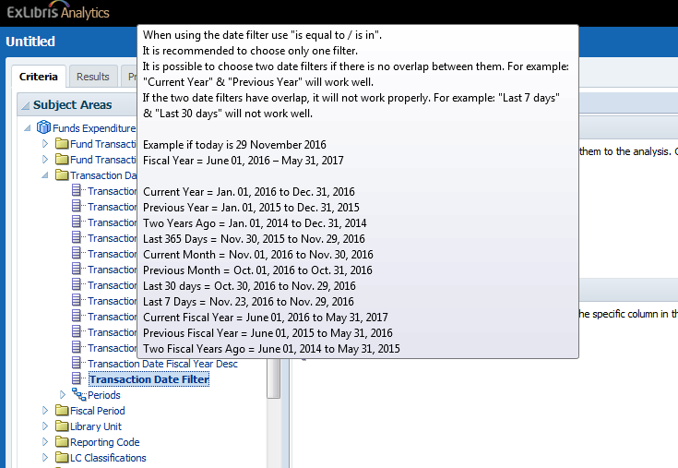
Introduction
Full instructions with examples
Mouse on date filter

Slide 10
Introduction
Examples
abc
https://slidemodel.com/templates/animated-rainbow-business-powerpoint-template/
http://image.shutterstock.com/z/stock-photo-business-hand-writing-blank-agenda-list-130255148.jpg

Slide 11
Number of returns per day in the last 7 days
Example One
Number of returns per day in the last 7 days

Slide 12
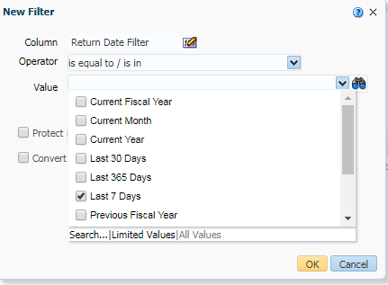
Number of returns per day in the last 7 days
Fulfillment subject area
The Return Date Filter = ‘Last 7 Days’

Slide 13
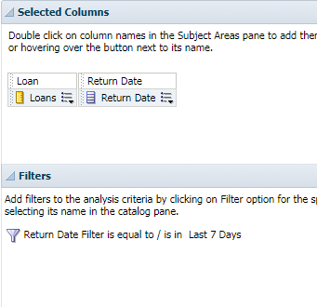
Number of returns per day in the last 7 days
Display the Return Date and Number of Loans

Slide 14
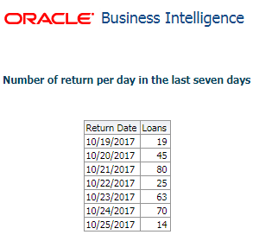
Number of returns per day in the last 7 days
Running on Oct. 25 2017 we get the following 7 days:

Slide 15
Expenditure per month for previous year
Example Two
Expenditure per month for previous year

Slide 16
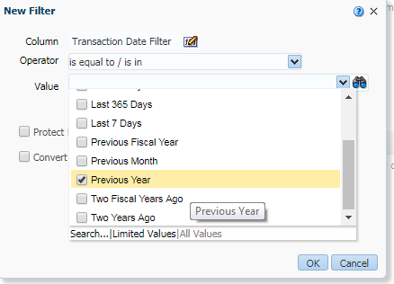
Expenditure per month for previous year
Funds Expenditures Subject Area
The Transaction Date Filter = ‘Previous Year’

Slide 17
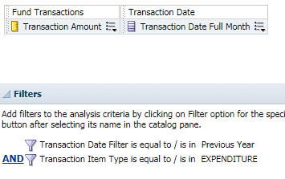
Expenditure per month for previous year
Display the Transaction Date Full Month and Number of Loans (Transaction Date Full Month includes the month and the year of the date)
Add filter for transaction type = Expenditure

Slide 18
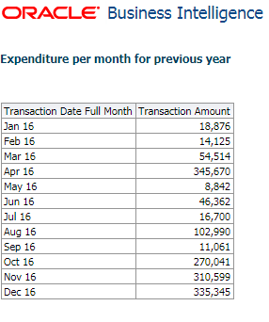
Expenditure per month for previous year
Running on Oct. 25 2017 we get the following which is all months of 2016:

Slide 19
JR1 Journal Usage per platform in current year
Example Three
JR1 Journal Usage per platform in current year

Slide 20
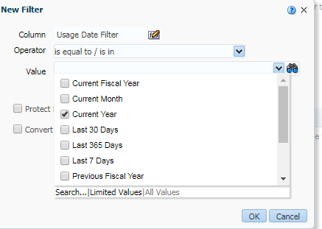
JR1 Journal Usage per platform in current year
Usage Data Subject Area
The Usage Date Filter = ‘Current Year’

Slide 21
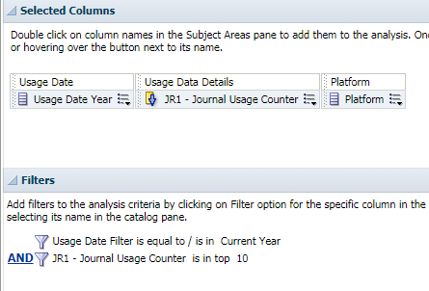
JR1 Journal Usage per platform in current year
Display the Usage Date Year, JR1 Journal Usage Counter, and Platform
Add filter for JR1 Journal Usage Counter is in top 10
Sort JR1 Journal Usage Counter descending

Slide 22
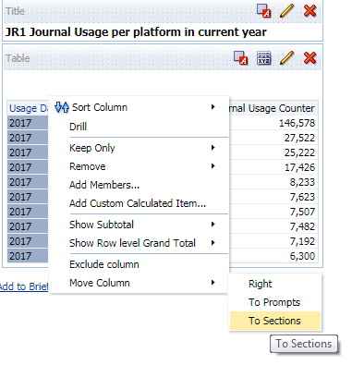
JR1 Journal Usage per platform in current year
Move the Usage Date Year to the Sections

Slide 23
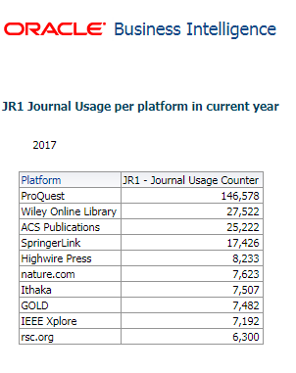
JR1 Journal Usage per platform in current year
Running on Oct. 25 2017 we get the following which is for year 2017:

Slide 24
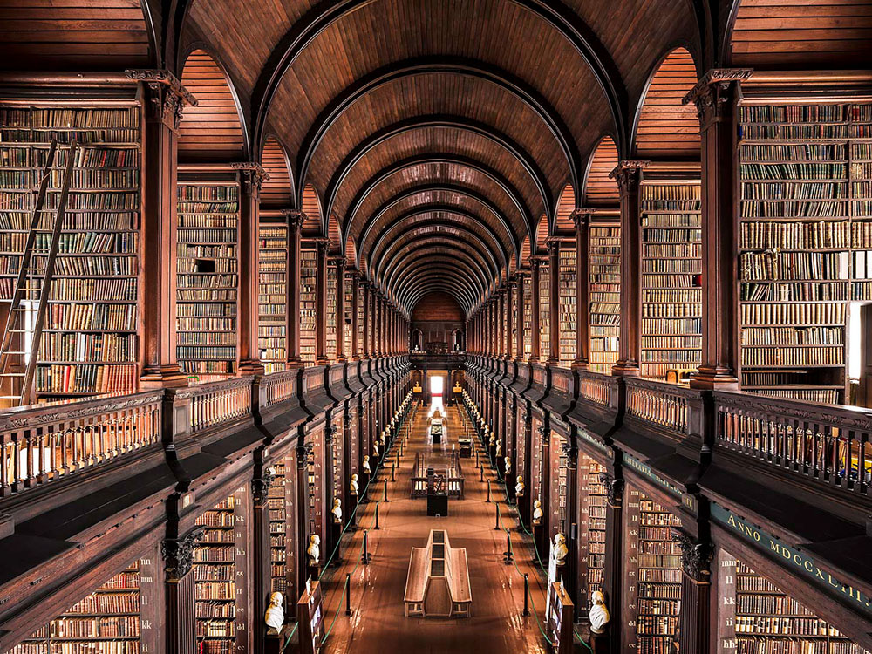
Thank you
Yoel Kortick
Senior Librarian
http://www.thisiscolossal.com/2017/06/enchanting-libraries-by-photographer-thibaud-poirier/

